Slide 1

Kaggle: Ovarian Cancer
By: Gregory Sylvester

Slide 2
Problem Statement
The problem presented is to take in different sets of images (originally TMA and WSI) to preprocess these and build a classifier model to output one of the 5 subtypes given.
Inputs: images PNG thumbnails
Output: cancer cell classification

Slide 3
Technical problems
When working on this project there are several technical problems that arise:
- image size and preprocess
- preprocessing WSI and TMA images is very exhaustive and intensive (size and different procedures), Solution: train using PNG thumbnails provided in dataset
- image size: while preprocessing most of the images were to big to finely capture the issues

Slide 4
Related work
Kaggle provides some of the most commonly used models for the projects and examples
1- UBC-Ovarian cancer(@EfficientNetB3)
2- [KerasCV] train and infer on thumbnails
3- Discord Kaggle server – Kaggle sponsored online fourm for helping to facilitate project
This is where I found my model I decided to use Timm EfficentNetB2

Slide 5
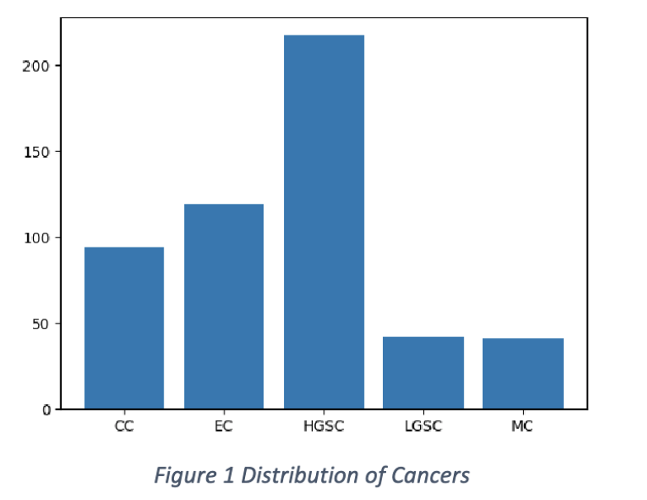
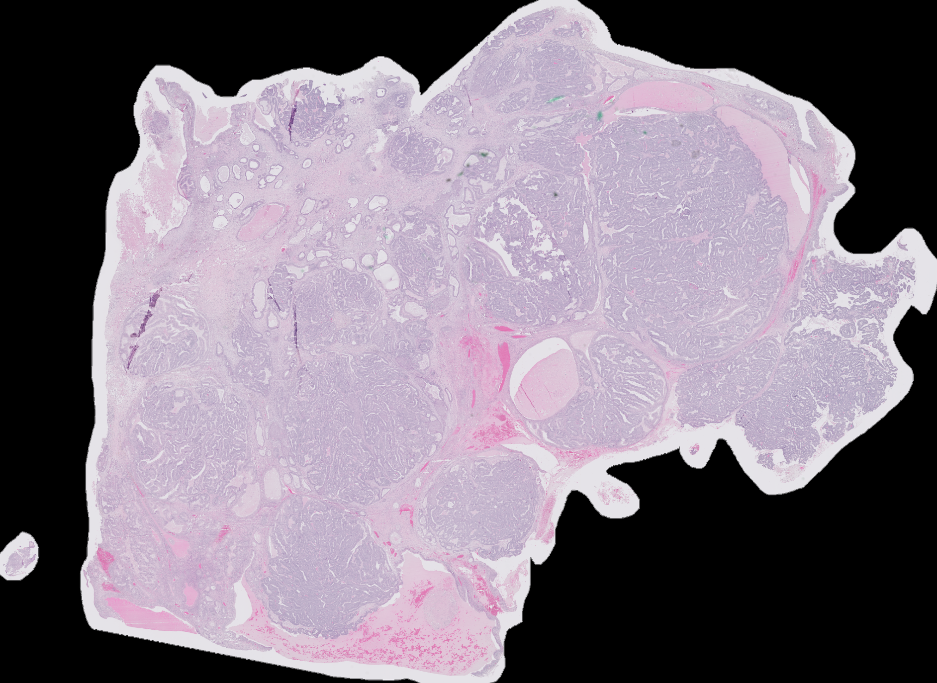
Data
513 thumbnails
- Image id
- classification (CC, EC, HGSC, LGSC, MC)
*After all data was augmented the data was wrapped in pytorch dataset
PNG of image

Slide 6
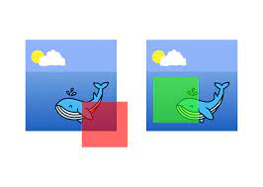
Crop (Augmentation)
For passing the PNG files into my model they needed to be 224 by 224 which meant some change was needed. Random cropping is a method by which the image is cropped to the input at random position in the image. This introduces regularization to the model

Slide 7
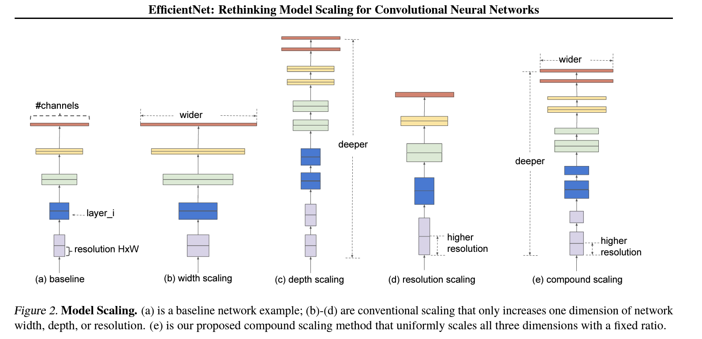
Model
EfficientNet is a CNN architecture designed to capture fine grain details of images for classification tasks by implementing a static scaling feature for the model
https://huggingface.co/docs/timm/models/efficientnet

Slide 8
Building model
Using the Timm prebuilt model I removed the predefined weights and only a few changes needed to be made.
- Timm provides helpful tutorials for training your own models
- Changing the classification layer at the bottom from 1000 to 5.
- The crit I set it to was log loss, a common metric for measuring the lost amount of information in classification.
- The optimizer was ADAM.

Slide 9
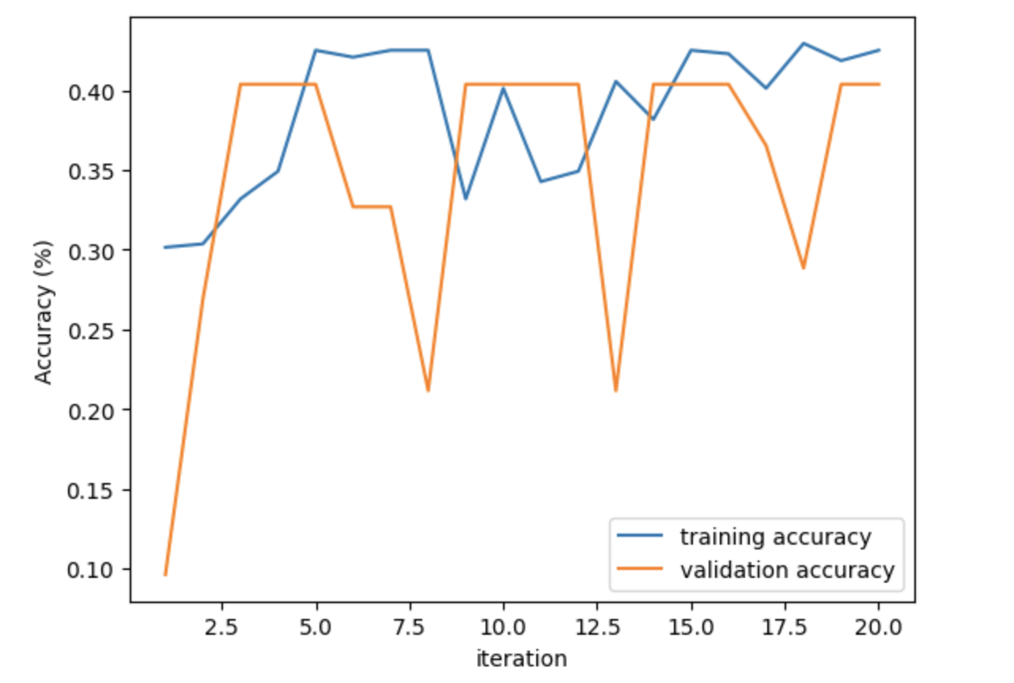
Training
- 20 epochs
- 16 batch size (tired larger batch size but the time started to go up for my pc)
- test .9 and validation .1
Results: Accuracy plateaued at ~.40 for the validation set
* Dips in the validation set are caused by the small sized batches. So misclassifying a few images caused major change in validation

Slide 10
Mistakes and Changes
For the initial stage of data exploration, I came to realization that preprocessing the large amount of data was to much and scaled back the challenge to using the png thumbnails. This retains much of the same information as the source images and removing a lot of preprocessing required
Batch size, I wanted to keep the batch size down to increase the amount of epochs without drastically increasing the time

Slide 11
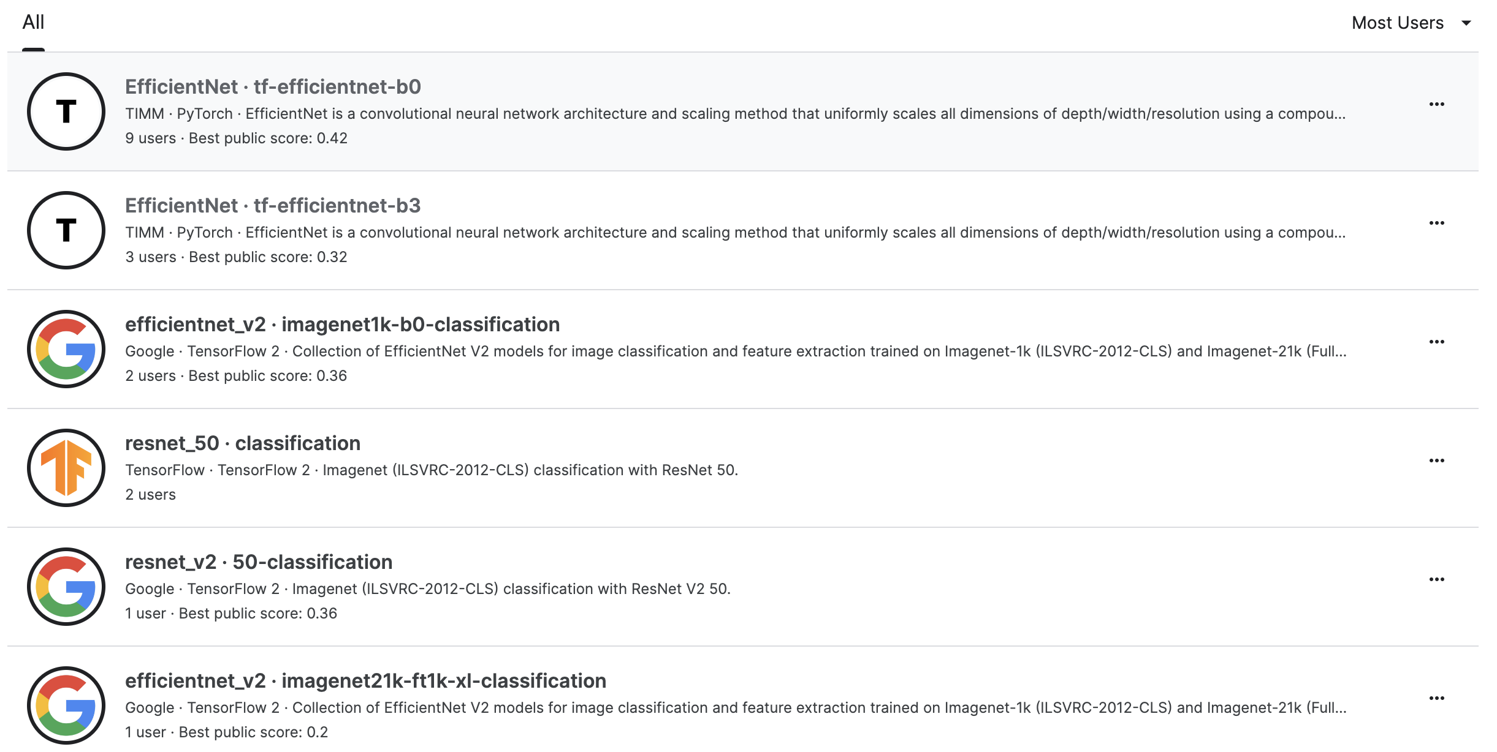
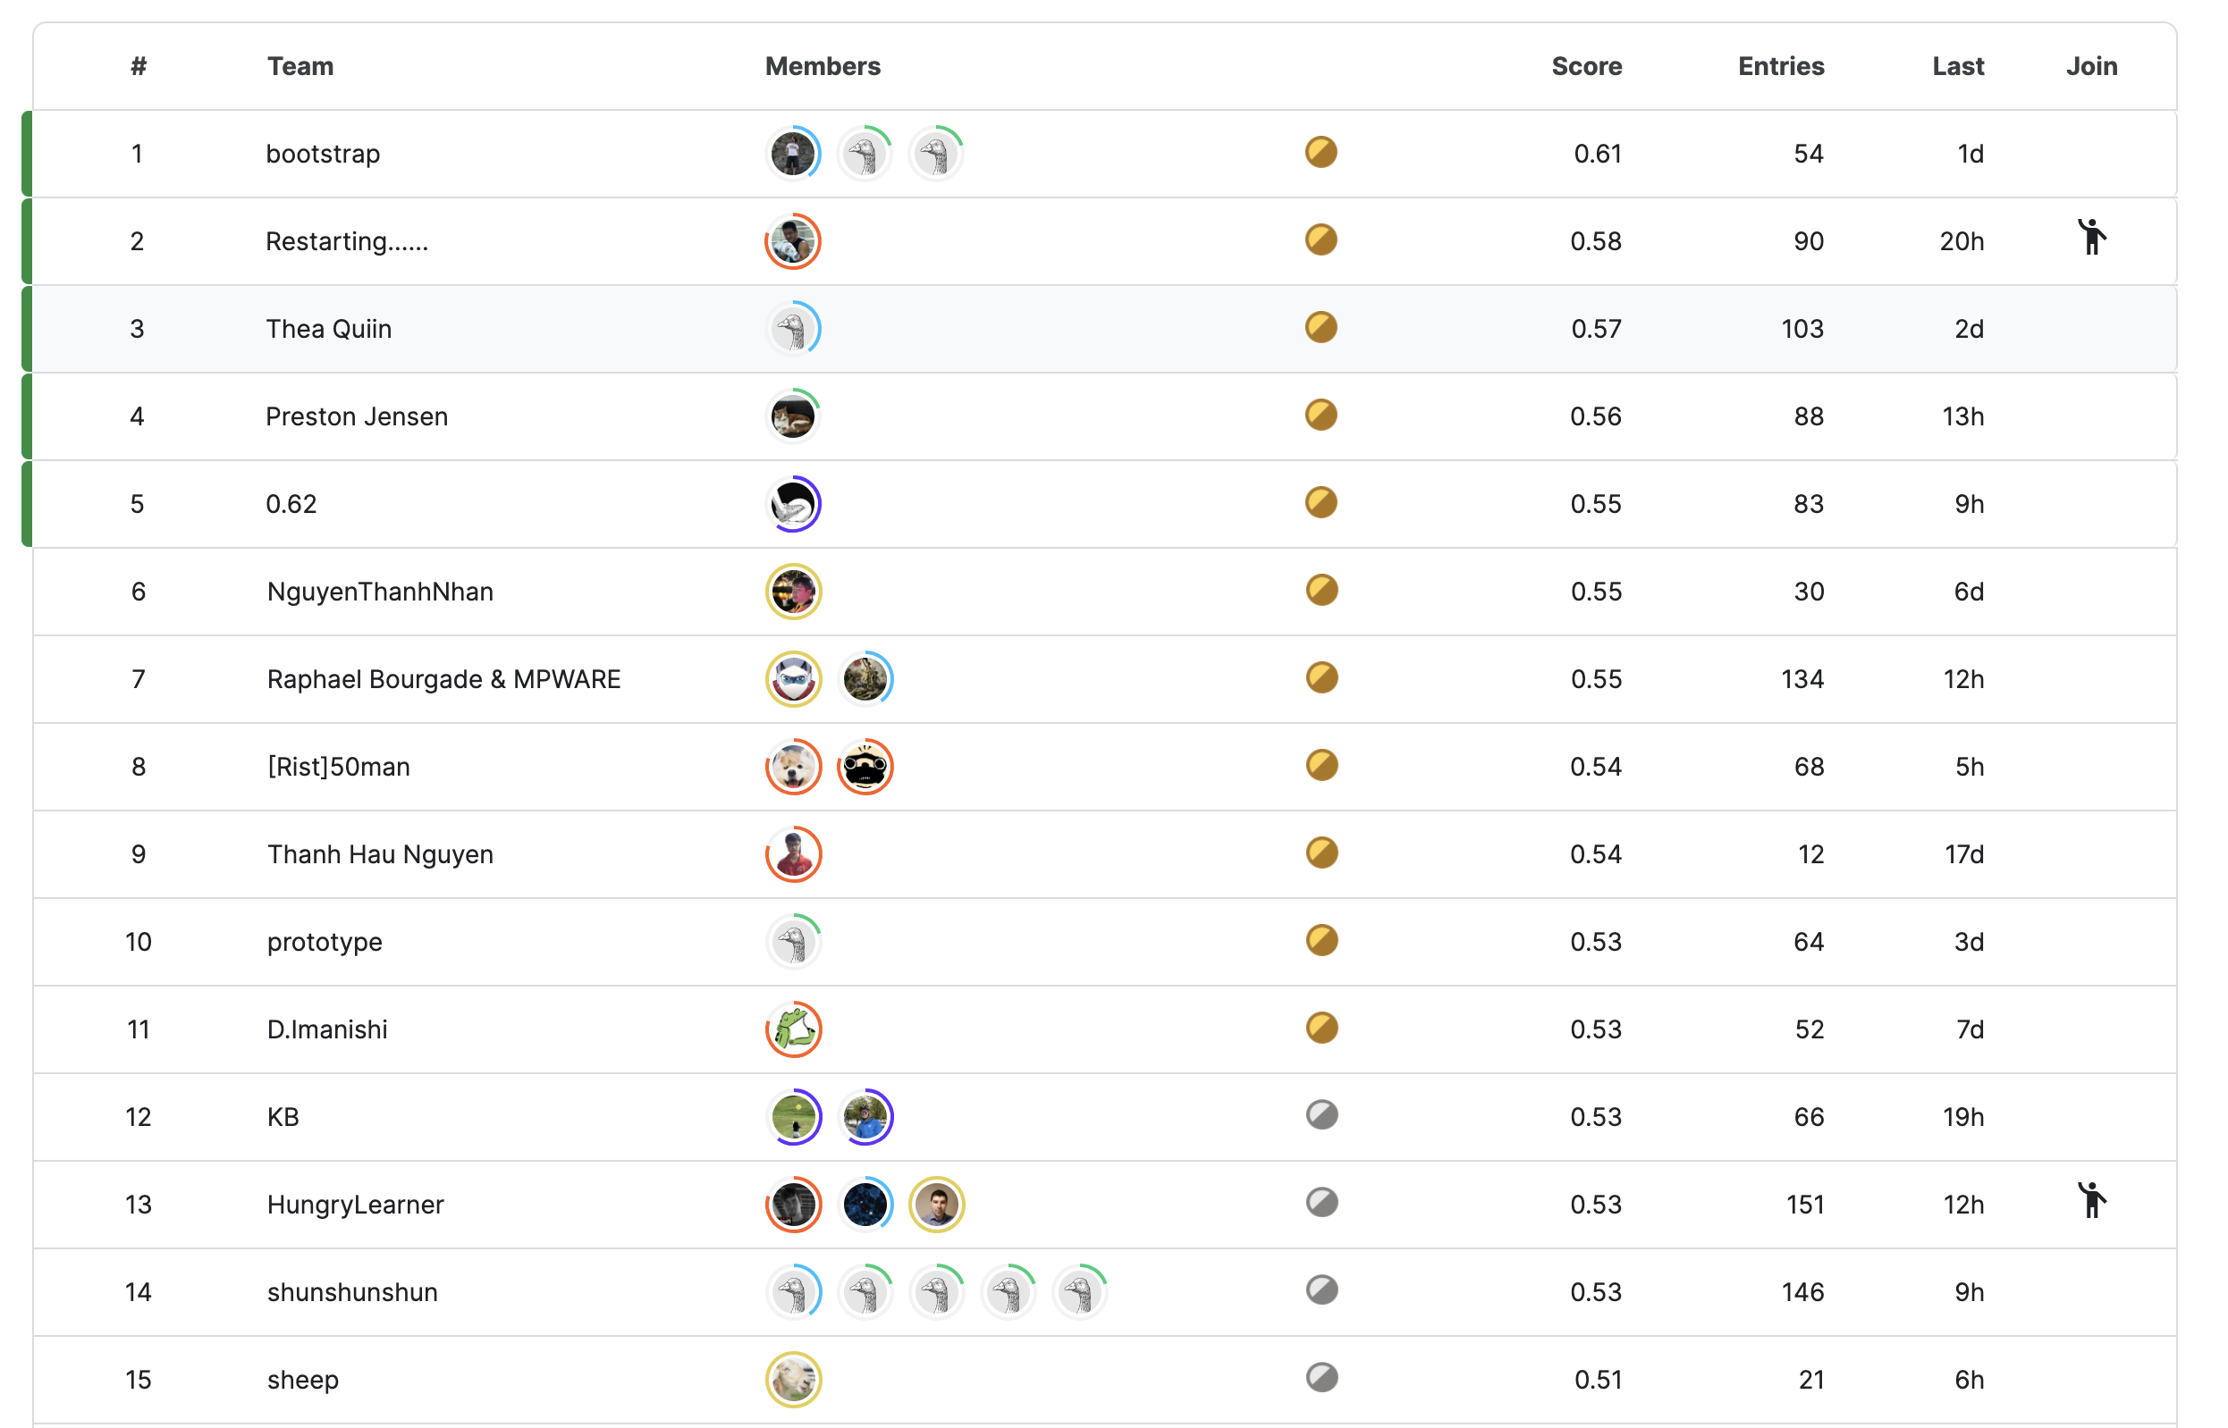
Status of Models in Competition
This Model returns relatively okay results from the current state of the competition it produces better results then all the other prebuilt (shared) models. Which achieved ~.36 - ~.42, however the other best efficientNetb0 implementation shared earlier has .42,

Slide 12
Question and Refrences
https://www.kaggle.com/competitions/UBCOCEAN
https://www.kaggle.com/competitions/UBCOCEAN/discussion
https://huggingface.co/docs/timm/models/efficient net
https://www.kaggle.com/code/aritrag/kerascvtrain-and-infer-on-thumbnails
https://www.kaggle.com/code/raviiloveyou/ubcovarian-cancer-efficientnetb3
https://www.kaggle.com/competitions/UBCOCEAN/models
https://timm.fast.ai/training

